Slide 1
PERCEPTION...
Something To Think About . . .

Slide 2
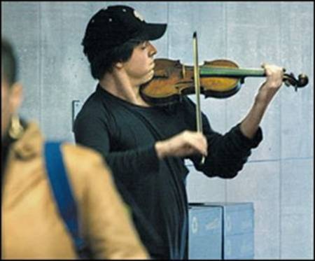
PRECEPTION
THE SITUATION In Washington, DC, at a Metro Station, on a cold January morning in 2007, this man with a violin played six Bach pieces for about 45 minutes.

Slide 3
PRECEPTION
During that time, approximately 2,000 people went through the station, most of them on their way to work. After about 3 minutes, a middle-aged man noticed that there was a musician playing.

Slide 4
PRECEPTION
He slowed his pace and stopped for a few seconds, and then he hurried on to meet his schedule.

Slide 5
PRECEPTION
About 4 minutes later: The violinist received his first dollar. A woman threw money in the hat and, without stopping, continued to walk.

Slide 6
PRECEPTION
At 6 minutes: A young man leaned against the wall to listen to him, then looked at his watch and started to walk again.

Slide 7
PRECEPTION
At 10 minutes: A 3-year old boy stopped, but his mother tugged him along hurriedly. The kid stopped to look at the violinist again, but the mother pushed hard.

Slide 8
PRECEPTION
The child continued to walk, turning his head the whole time. This action was repeated by several other children, but every parent - without exception - forced their children to move on quickly.

Slide 9
PRECEPTION
At 45 minutes: The musician played continuously. Only 6 people stopped and listened for a short while. About 20 gave money but continued to walk at their normal pace. The man collected a total of $32.

Slide 10
PRECEPTION
After 1 hour: He finished playing and silence took over. No one noticed and no one applauded. There was no recognition at all.

Slide 11
No one knew this, but the violinist was Joshua Bell, one of the greatest musicians in the world. He played one of the most intricate pieces ever written, with a violin worth $3.5 million dollars. Two days before, Joshua Bell sold-out a theater in Boston where the seats averaged $200 each to sit and listen to him play the same music.

Slide 12
This is a true story. Joshua Bell, playing incognito in the D.C. Metro Station, was organized by the Washington Post as part of a social experiment about perception, taste and people's priorities.

Slide 13
This experiment raised several questions: * In a common-place environment, at an inappropriate hour, do we perceive beauty? * If so, do we stop to appreciate it? * Do we recognize talent in an unexpected context?

Slide 14
One possible conclusion reached from this experiment could be this: If we do not have a moment to stop and listen to one of the best musicians in the world, playing some of the finest music ever written, with one of the most beautiful instruments ever made . . .

Slide 15
How many other things are we missing as we rush through life?

