Slide 1
The Computer Expert

Slide 2
Dear Various Parents, Grandparents, Co-workers, and other “Not Computer People.” We don’t magically know how to do everything in every program. When we help you, we’re usually just doing this:

Slide 3
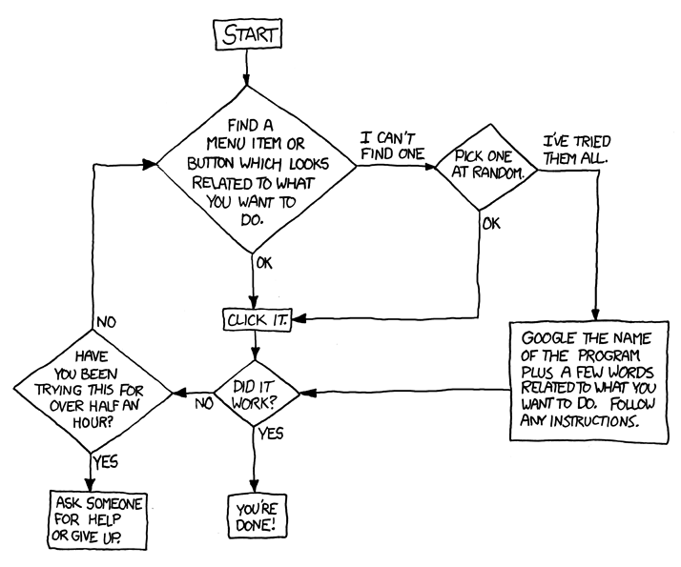

Slide 4
Please print this flowchart out and tape it near your screen. Congratulations; You’re now the Local computer Expert!

