Slide 1
TEN tips for the New Year

Slide 2
1) Do not get into trouble.

Slide 3
2) Aim for greater heights.

Slide 4
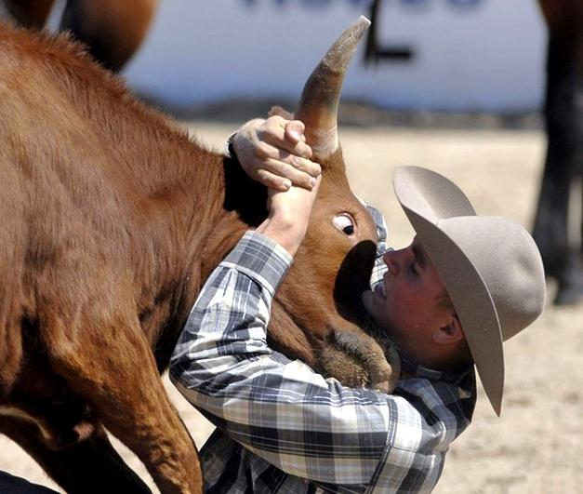
3) Stay focused on your job.

Slide 5
4) Exercise to maintain good health.

Slide 6
5) Practice Team work.

Slide 7
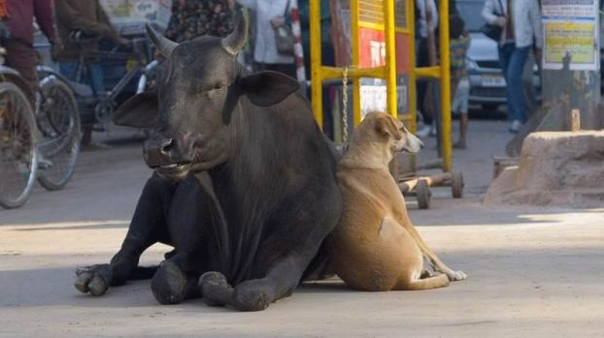
6) Rely on your trusted partner to watch your back.

Slide 8
7) Save for rainy days.

Slide 9
8) Rest and relax.

Slide 10
9) Always smile when your boss is around.

Slide 11
10) Nothing is impossible.

