Slide 1
Color is Good

Slide 2
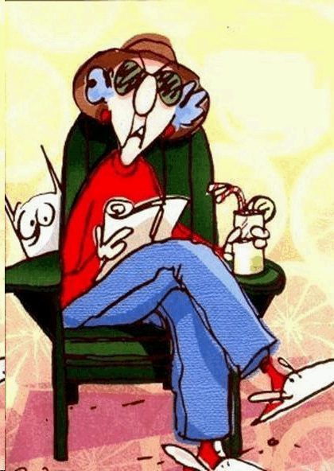
Yesterday I went to the doctor for my yearly physical.

Slide 3
My blood pressure was high, my cholesterol was high,

Slide 4
I'd gained some weight, and I didn't feel so hot.

Slide 5
My doctor said eating right doesn't have to be complicated and it would solve my physical problems.

Slide 6
He said just think in colors...

Slide 7
Fill your plate with bright colors... greens, yellows, reds, etc.

Slide 8
I went right home and ate an entire bowl of :

Slide 9
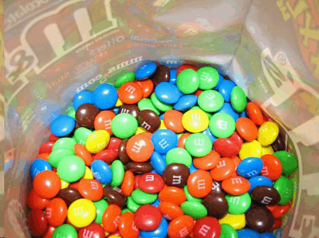
Colors!

Slide 10
And sure enough, I felt better immediately.

Slide 11
I never knew eating right could be so easy.

