Slide 1
Some of us have seen the first three or four pix, but keep going, it gets interesting.
One of our newest on a carrier
Check out the driver....

Slide 2
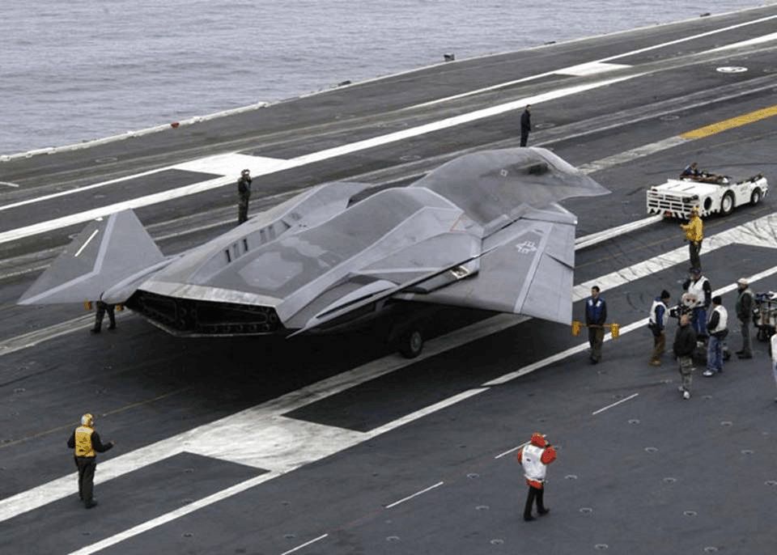

Slide 3
The plane in these pictures is still officially the 'Air Vehicle Number 1', a prototype, on board the USS George Washington CVN-73 for catapult fit checks. Not exactly still Top Secret but certainly not yet made public.
It will be known as the F/A-37. Although specs are Classified, it is believed to be Mach 3.5 (top speed in the Mach 4 range), super-cruise stealth Fighter/bomber/inter ceptor with approximately a 4,000nm Range. Awesome!
Check out the Navy test pilot in the cockpit of the F/A-37...LT Kara Wade

Slide 4
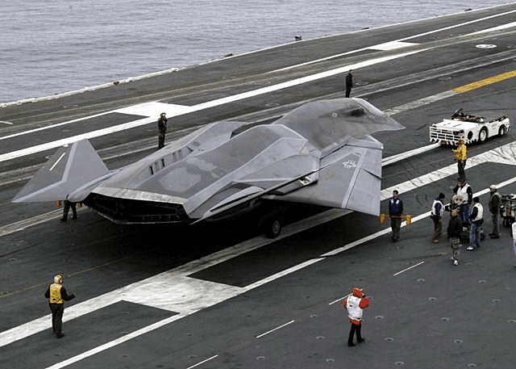

Slide 5
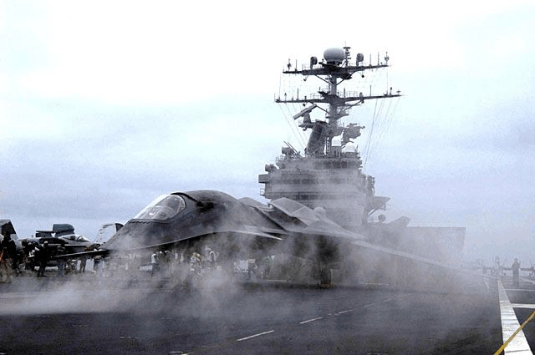

Slide 6
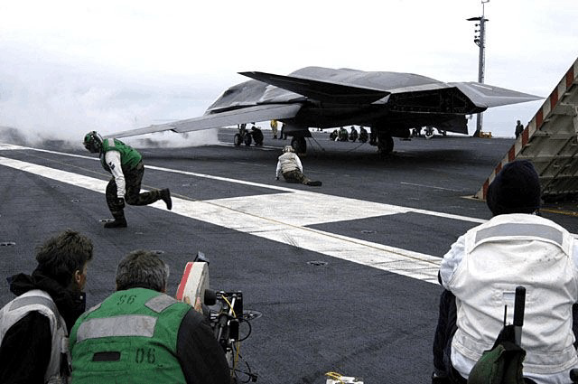

Slide 7
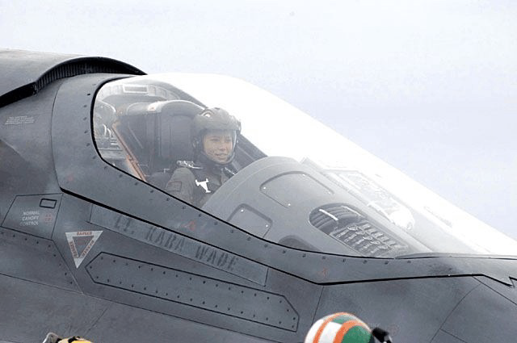

Slide 8
And there is More
For the first time in over 20 some odd years, three carrier strike groups got together in formation for a great photo op.
From top to bottom are the aircraft carriers, ABRAHAM LINCOLN, KITTY HAWK, and RONALD REAGAN.
We even had Air Force planes fly-over, see the B-2 Stealth Bomber in the fifth & seventh picture down. The only warships not seen in the photos are the 4 nuclear powered submarines standing guard. WOW

Slide 9
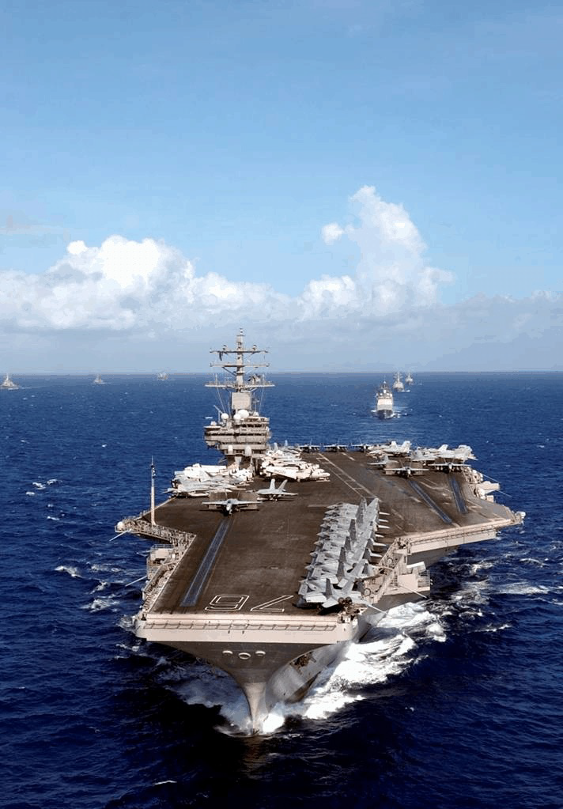

Slide 10
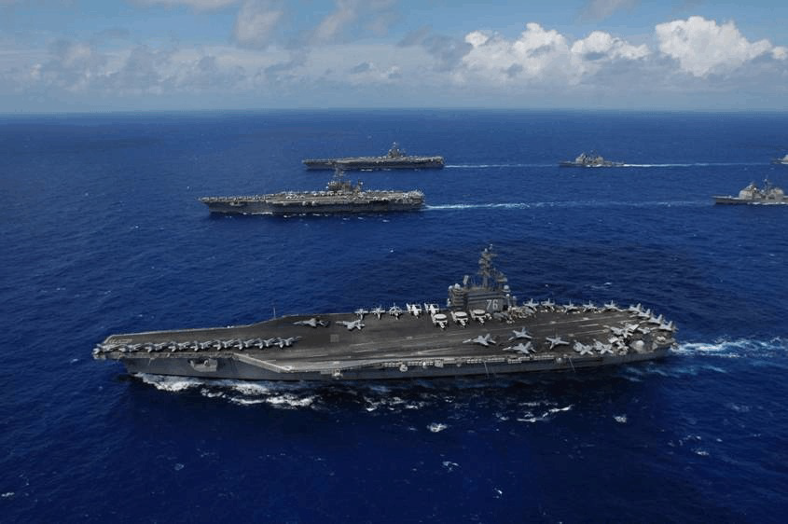

Slide 11
PACIFIC OCEAN, (June 18, 2006) - USS Ronald Reagan (CVN 76) (foreground), USS Kitty Hawk (CV 63) (middle), USS Abraham Lincoln (CVN 72) and their associated carrier strike Groups steam in formation while 17 aircraft from the Air Force, Navy, and Marine Corps fly over them during a joint photo exercise (PHOTOEX) while preparing for exercise Valiant Shield 2006.
The Kitty Hawk Carrier Strike Group is currently participating in Valiant Shield 2006, the largest joint Exercise in recent history. Held in the Guam operating area June 19-23, the exercise includes 28 Naval vessels including three carrier strike groups. Nearly 300 aircraft and approximately 22,000 service members from the Navy, Air Force, Marine Corps, and Coast Guard are also participating in the exercise. Official U.S. Navy photo by Chief Photographer's Mate Todd P.

Slide 12
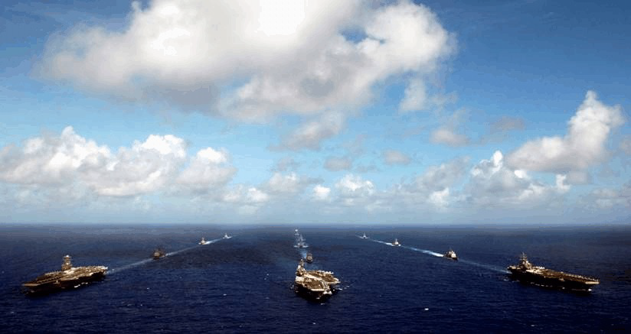

Slide 13
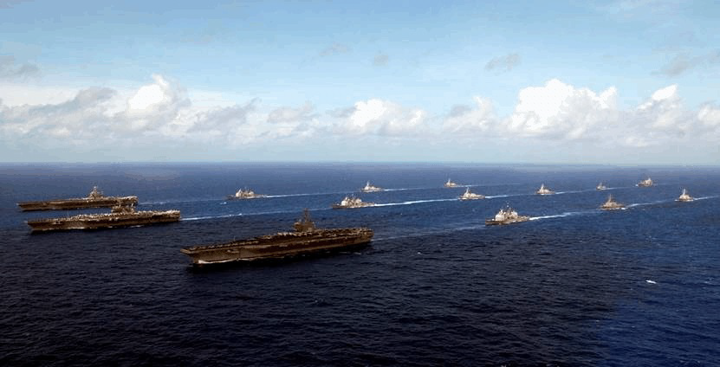

Slide 14
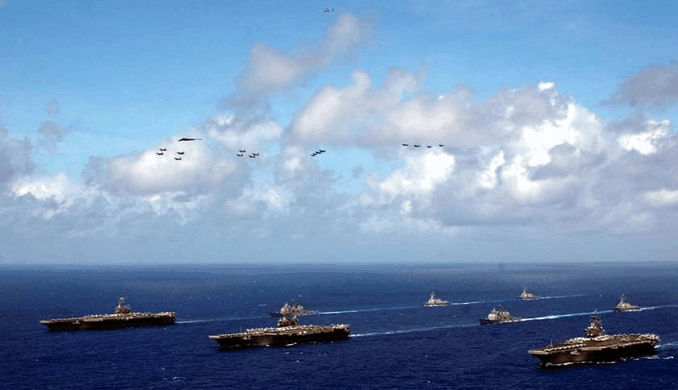

Slide 15
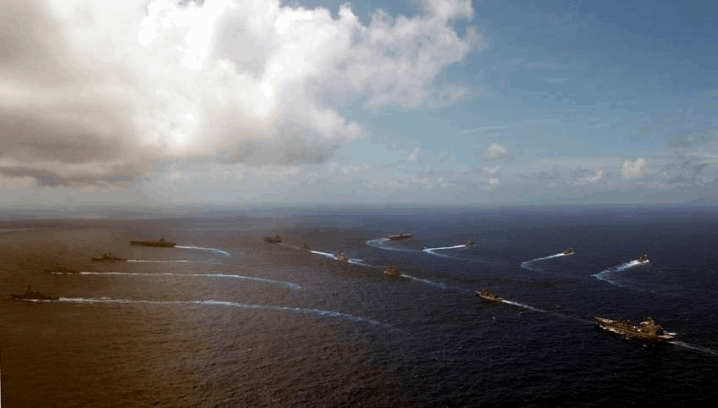

Slide 16
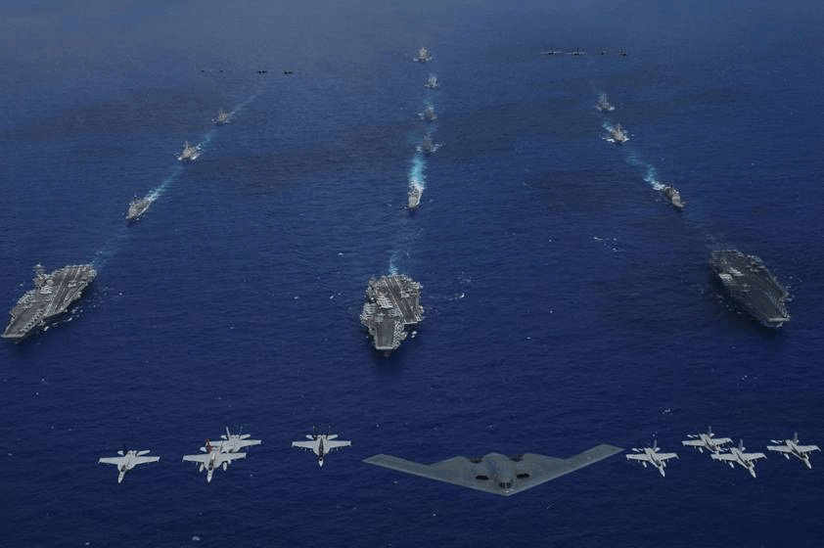

Slide 17
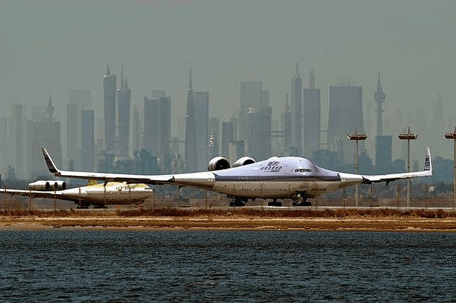

Slide 18
Look at this new aircraft....
Boeing is preparing a 1000 passenger jet that could reshape the Air travel industry for the next 100 years. The radical Blended Wing design has been developed by Boeing in cooperation with the NASA Langley Research Center. The mammoth plane will have a wing span of 265 feet compared to the 747's 211 feet, and is designed to fit within the newly created terminals used for the 555 seat Airbus A380, which is 262 feet wide.
The new 797 is in direct response to the Airbus A380 which has racked up 159 orders, but has not yet flown any passengers. Boeing decide to kill its 747X stretched super jumbo in 2003 after little interest was shown by airline companies, but has continued to develop the ultimate Airbus crusher 797 for years at its Phantom Works research facility in Long Beach, Calif.

Slide 19
The Airbus A380 has been in the works since 1999 and has accumulated $13 billion in development costs, which gives Boeing a huge advantage now that Airbus has committed to the older style tubular aircraft for decades to come.
There are several big advantages to the blended wing design, the most important being the lift to drag ratio which is expected to increase by an am azin g 50%, with overall weight reduced by 25%, making it an estimated 33% more efficient than the A380, and making Airbus's $13 billion dollar investment look pretty shaky.

Slide 20
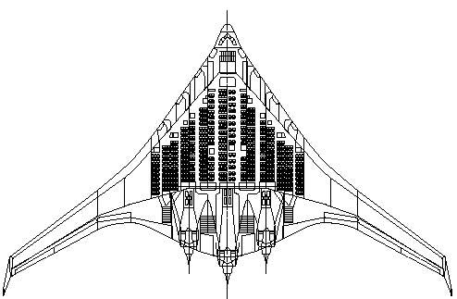

Slide 21
High body rigidity is another key factor in blended wing aircraft, It reduces turbulence and creates less stress on the air frame which adds to efficiency, giving the 797 a tremendous 8800 nautical mile range with its 1000 passengers flying comfortably at mach 0.88 or 654 mph (+ -1046km/h) cruising speed another advantage over the A irbus tube-and-wing des igned A380‘s 570 mph (912 km/h).
The exact date for introduction is unclear, yet the battle lines are clearly drawn in the high-stakes war for civilian air supremacy.

